Slide 1
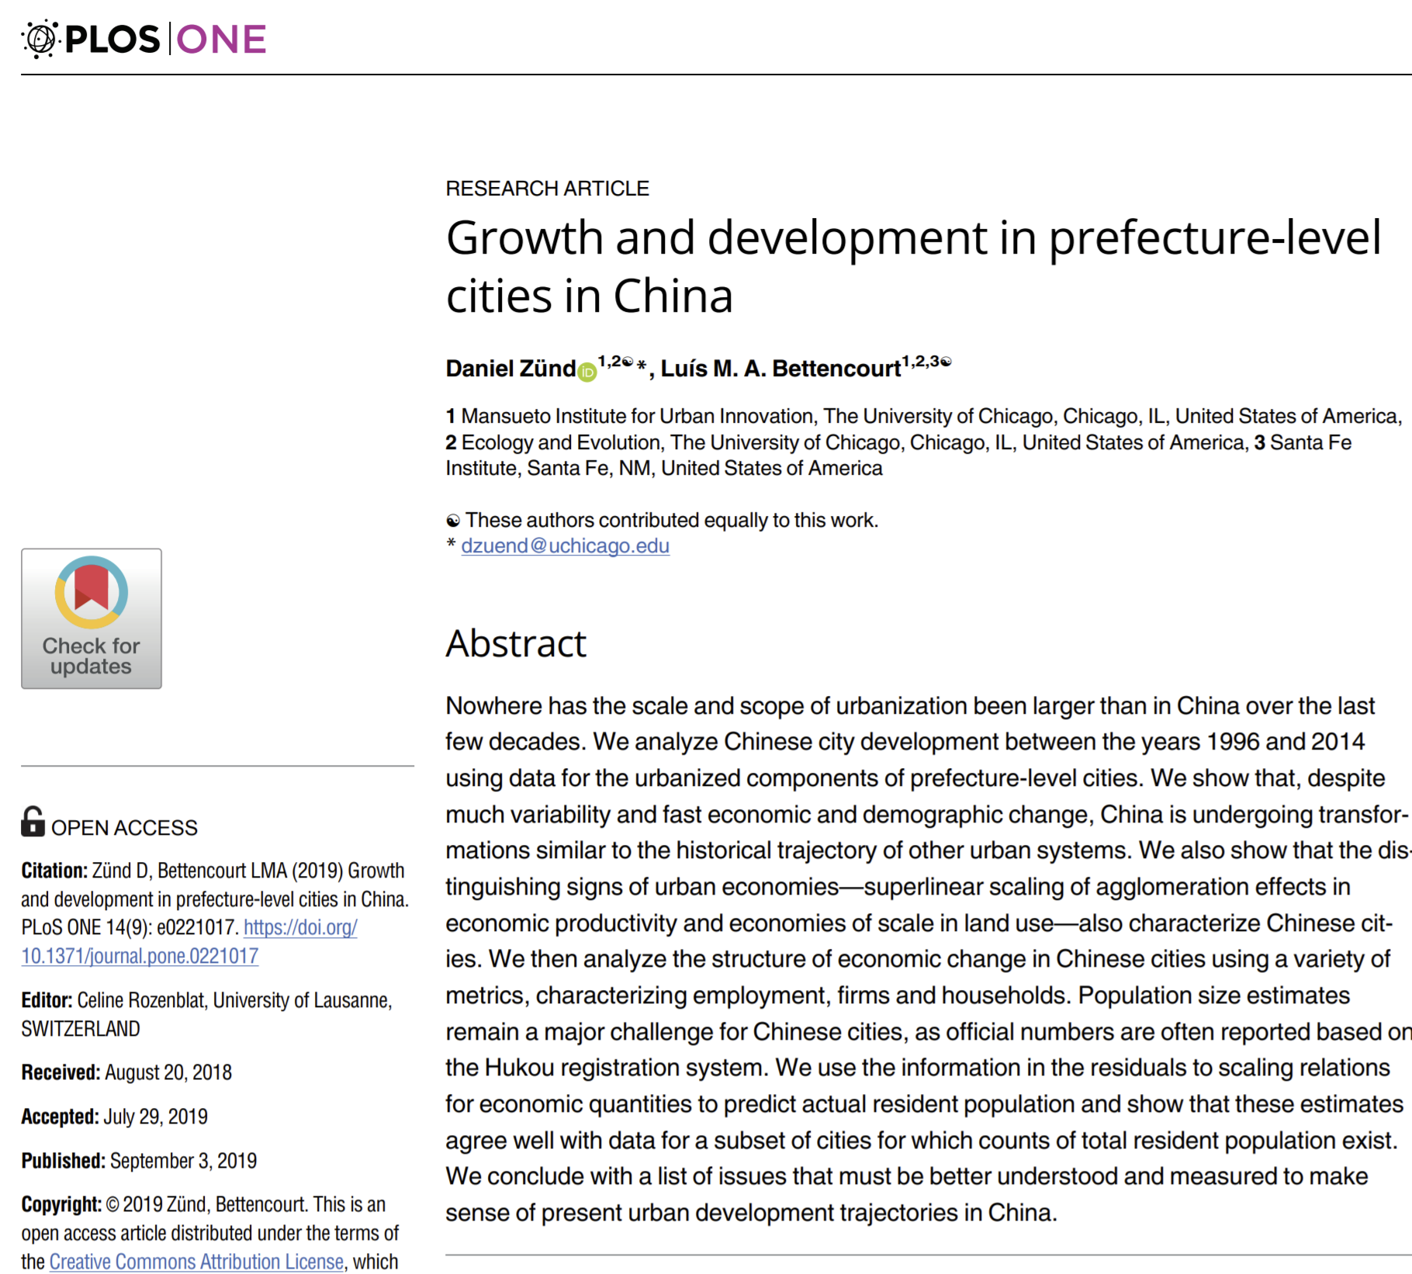
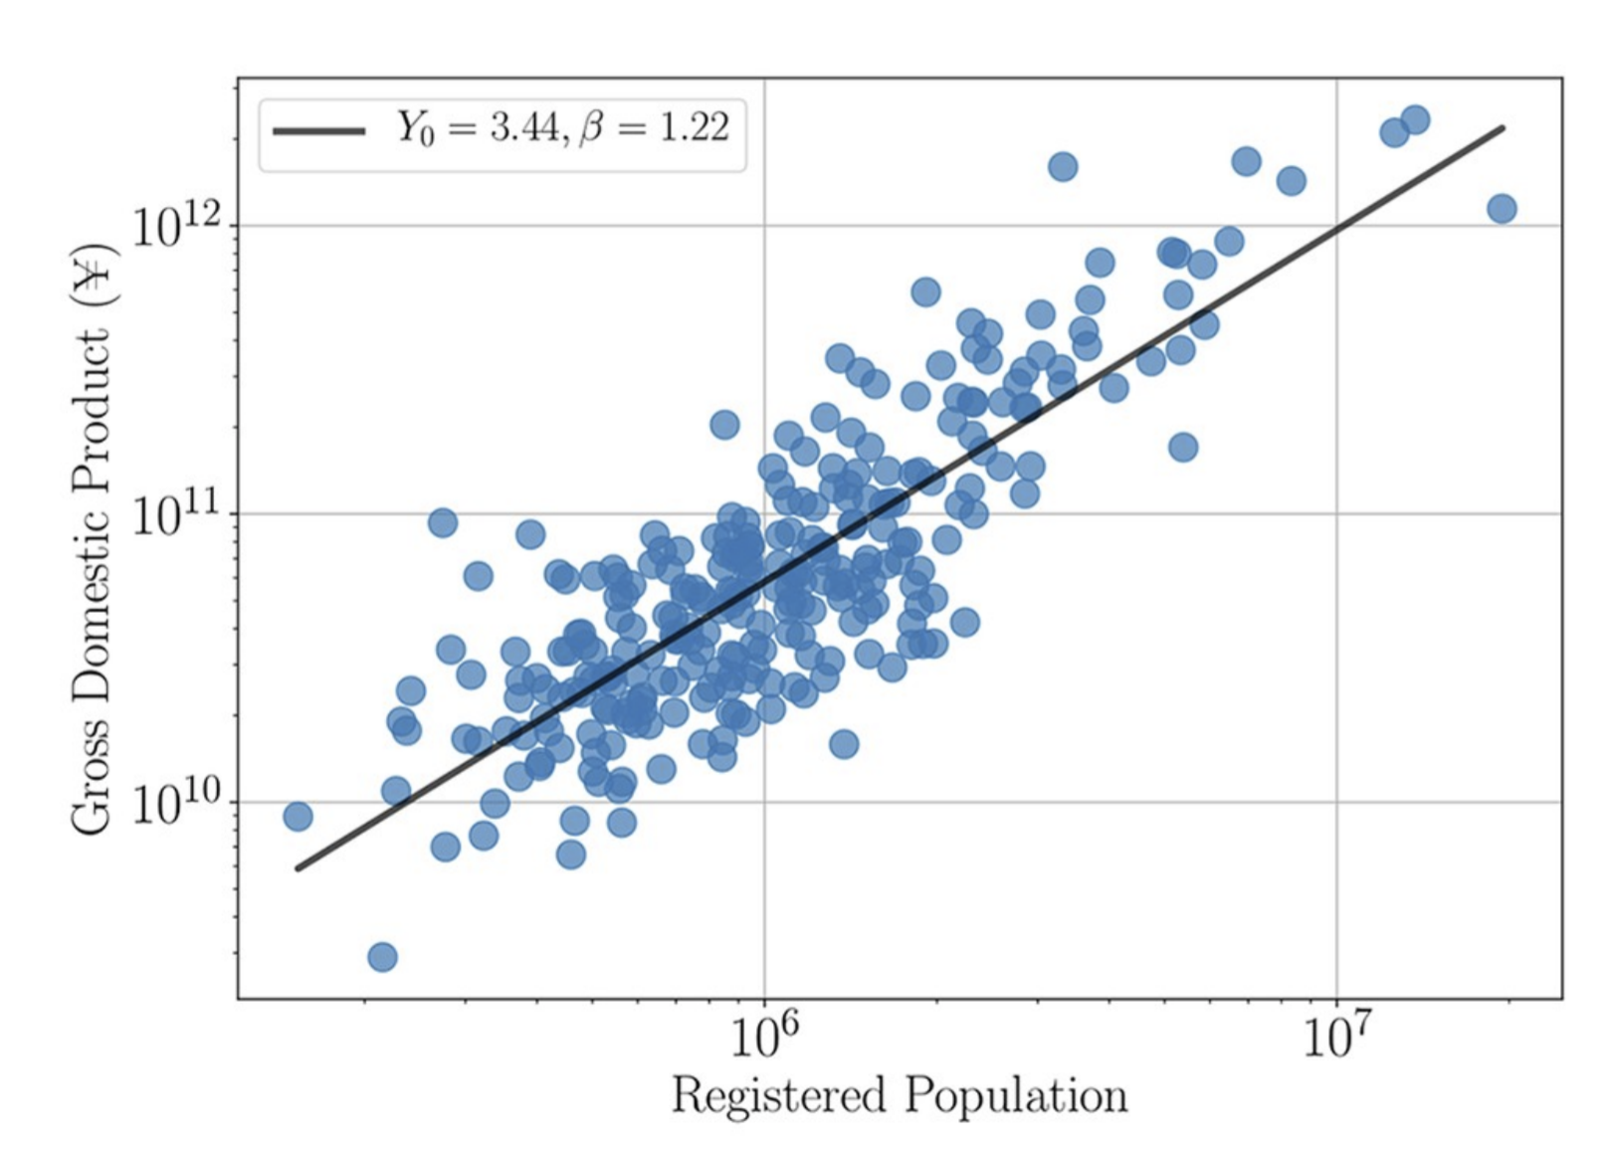
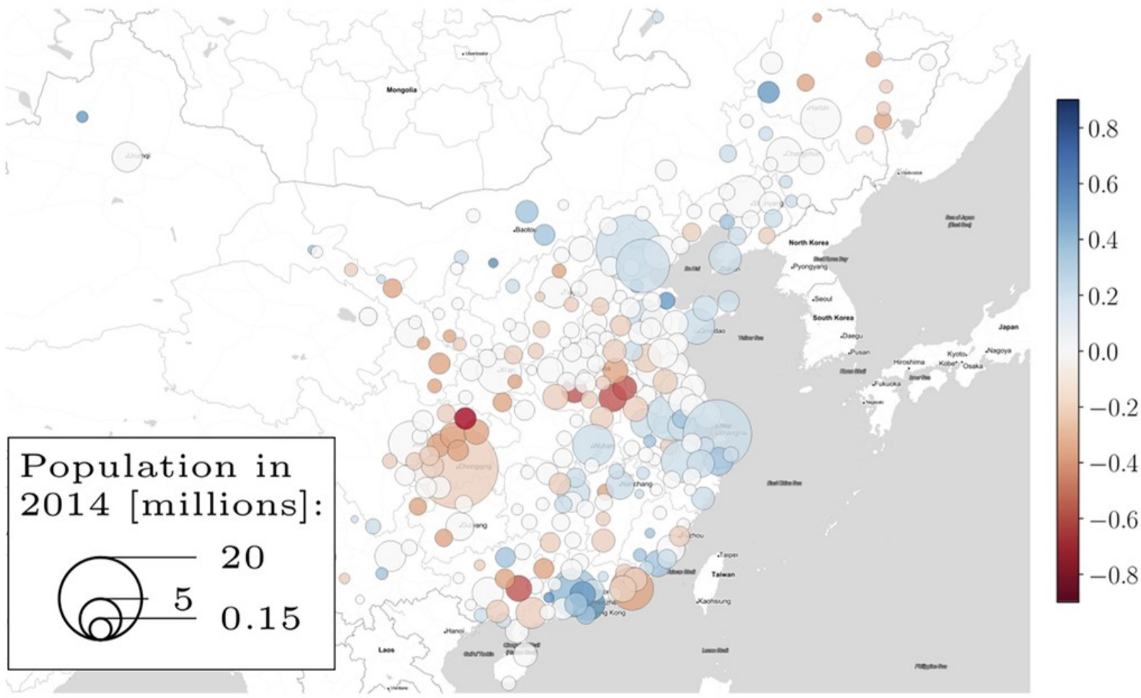
Case Study Four: Growth and development in prefecture-level cities in China
Zünd D, Bettencourt LMA (2019) Growth and development in prefecture-level cities in China. PLoS ONE 14(9): e0221017. https://doi.org/10.1371/journal.pone.0221017
Objectives: To estimate actual resident population of prefectural cities of China using GDP/population residual
Data Sources
China Data Online
Data
GDP, Population, Size of Prefectural Cities (2014) (China Data Online)
Resident Population of Chinese Cities (2014) (Paper)

Slide 2
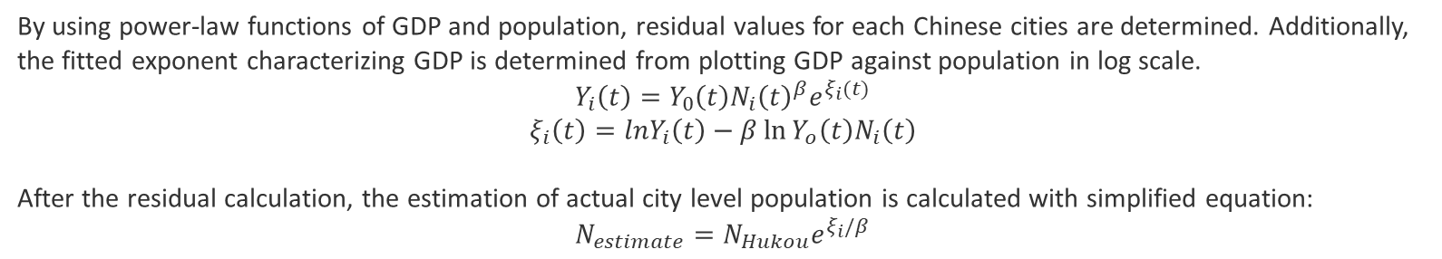
Case Study Four: Growth and development in prefecture-level cities in China
Methodology
By using power-law functions of GDP and population, residual values for each Chinese cities are determined. Additionally, the fitted exponent characterizing GDP is determined from plotting GDP against population in log scale.
$$Y_{i}\left(t\right)=Y_{0}\left(t\right)N_{i}{\left(t\right)}^{β}e^{ξ_{i}(t)}$$
$$ξ_{i}\left(t\right)=lnY_{i}\left(t\right)−β\ln{Y_{o}\left(t\right)N_{i}\left(t\right)}$$
After the residual calculation, the estimation of actual city level population is calculated with simplified equation:
$$N_{estimate}=N_{Hukou}e^{ξ_{i}/β}$$
Flowchart
Data Inputs
GDP, Population, Size of Prefectural Cities
Data Analysis
Outputs
Power-Law Functions
Histogram
Resident Population
Data
Residual Calculation
Scatter Plot
Fitted Exponent Calculation
Log Scale Plots
City Level Shapefile

Slide 3
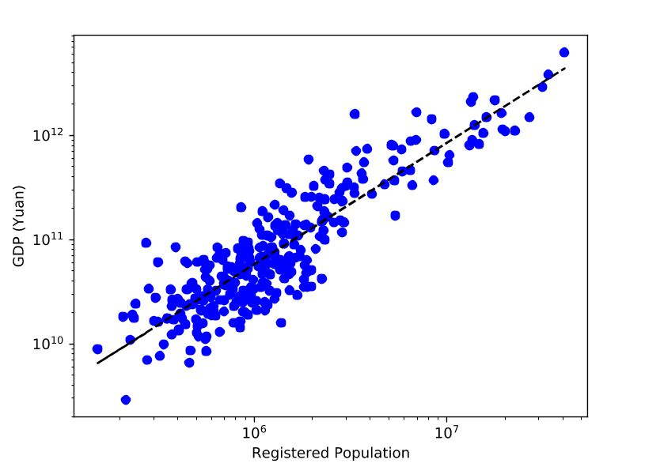
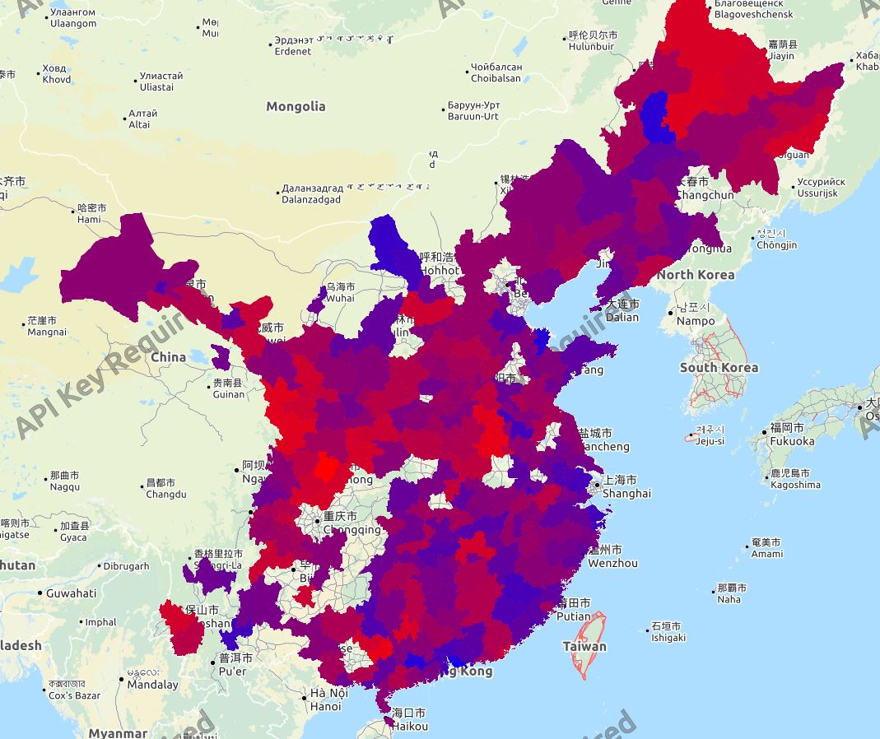
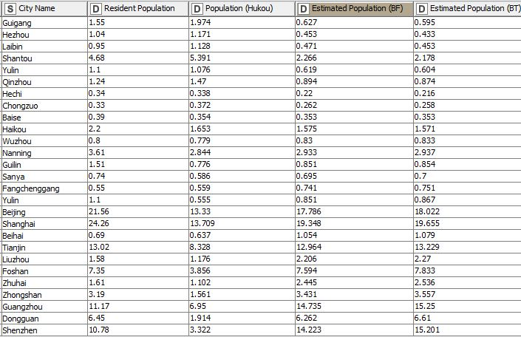
Case Study Four: Growth and development in prefecture-level cities in China
Outputs from the Workflow
Spatial Distribution of the Residual Level
Red: Low Residual: Low performing cities
Blue: High Residual; Highly performing cities
Actual, Hukou, and Estimated Actual Population of Prefectural Cities in China
The superlinear scaling law:
GDP vs. Population Size (2014)

Slide 4
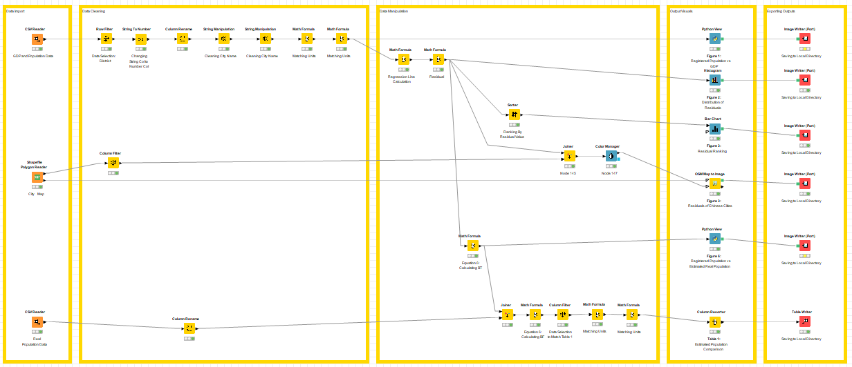
Case Study Four: Growth and development in prefecture-level cities in China
Residual Calculation
Estimation of
City Level Population

Slide 5
Case Study Four: Growth and development in prefecture-level cities in China
Steps for Running the Workflow
Step 1: Download data and unzip from https://drive.google.com/drive/u/0/folders/1a-PnfH527p8itlHM6alNEy8T33hSjvwF
Step 2: Download workflow from https://drive.google.com/drive/u/0/folders/1yZC9a0lL93x9a4EmmqHp-Wzy3LZiZCjW
Step 3: Open KNIME from local PC or China Data Lab Cloud Platform (in building)
Step 4: Import KNIME workflow file (Growth and development in prefecture-level cities in China.knwf)
Step 5: Configure all nodes in “data collection”
Step 6: Configure all nodes in “exporting output”
Step 6: Click Run function from the top menu
Step 7: Display the outputs:
Figure 1: Registered Population vs. GDP
Figure 2: Distribution of Residuals
Figure 3: Residual Ranking
Figure 3-2: Residual Ranking Map
Figure 6: Registered Population vs. Estimated Real Population
Table 1: Estimated Population Comparison

Slide 6
Case Study Four: Growth and development in prefecture-level cities in China
Summary
The workflow replicates the paper’s main parts and visualize the results in forms of tables, charts, and a map.
From the results, it is found that the methodology that the author suggested improves population estimation of prefectural cities of China. The method works especially well for cities with a large population.
Limitation
The data that this KNIME workflow uses for prefectural cities of China’s GDP and population differ from the research paper. From the paper, it is not too clear which cities the author included and excluded when calculating the residual and exponent variables. Due to the differences of the data, the outputs of the workflow slightly differ from that of the paper.

Slide 7
References
Zünd D, Bettencourt LMA (2019) Growth and development in prefecture-level cities in China. PLoS ONE 14(9): e0221017. https://doi.org/10.1371/journal.pone.0221017
China Data Online https://www.china-data-online.com/

